Slide 1
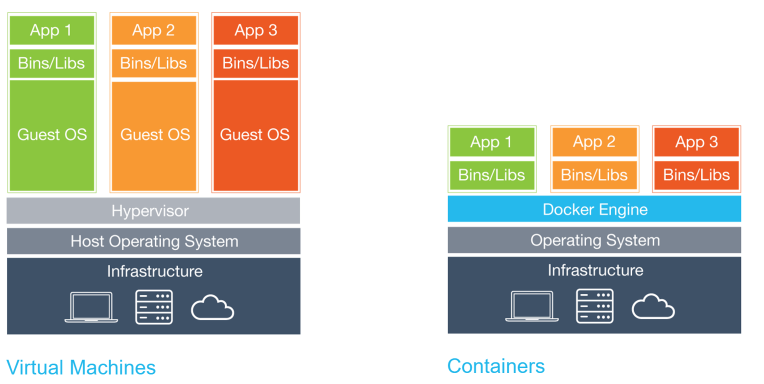

What is Docker?

Slide 2

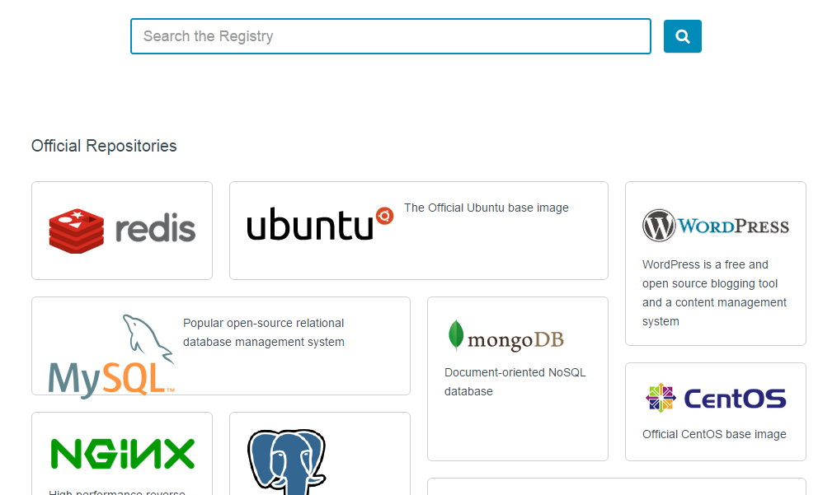
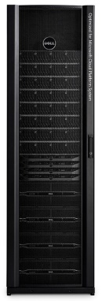
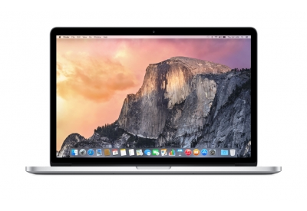
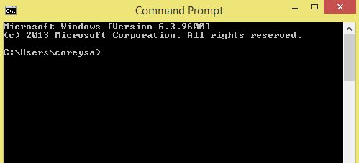
How containers are being used? Why is everyone so excited?
Fast and agile
Unified deployment technology
Unified packaging format
Huge community
Prod
Dev
Test

Slide 3

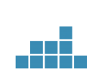

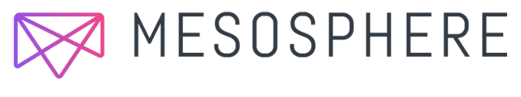

Azure Container Service
App 2
What is the feature?
App 1
App 3
Azure Container Service builds on our work with Docker and Mesosphere to create and manage scalable clusters of host machines onto which containerized applications can be deployed, orchestrated, and managed.
By leveraging Azure Container Service Resource Provider for Azure Resource Manager (ARM), Azure Container Service will make it easy for you to create and manage clusters of hosts pre-configured with Docker, Apache Mesos, Marathon and Docker Swarm. This work couples Azure's hyper-scale and enterprise-grade cloud with proven open source technologies to deliver the foundation for the container deployment, orchestration, and management service any team building container apps will need.
Docker Compose
Docker swarm
Marathon, Chronos
VM
VM
VM
Mesos cluster
Azure Management and Ecosystem

